Slide 1
Flying: To Fear or Not to Fear?
By Megan Byard

Slide 2
Hypothesis
Many individuals have a fear of flying. This may be for a multitude of reasons but a common one seems to be due to the fear of crashing. We hear about plane crashes on a fairly regular basis, which in my mind seems to have increased in recent years. Maybe this is just because I’ve gotten older and pay more attention to what’s going on in the world. Or, perhaps there’s more media coverage, making it more likely we will hear about them. I’m taking a dive in to see if there is indeed an increase in aviation crashes, specifically with fatalities.

Slide 3
Variables Chosen
ActvTtl – Number of active aircraft by primary use, total
FltHrsTtl – Number of flight hours by actual use, total(thousands)
FatalTtl – Fatalities total
AccTtl – Accidents total
FatalRT – Fatality Rate

Slide 4
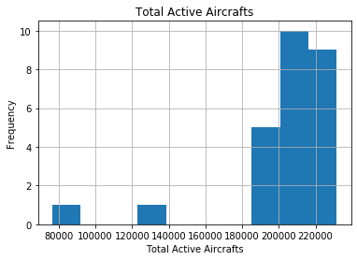
Total Active Aircraft Histogram
Outliers: One year there were only 80,000 aircrafts active which is significantly less than other years, however it should remain in the data.

Slide 5
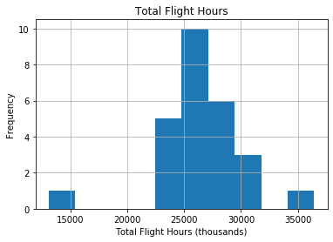
Total Flight Hours Histogram
Outliers: One year there were only about 13,000,000 flight hours. This was the earliest year the data was captured in the data set and should remain in the data.

Slide 6
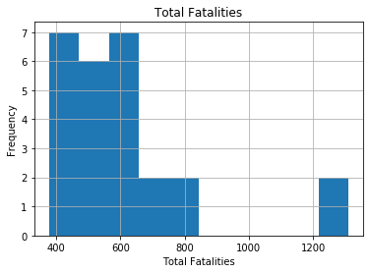
Total Fatalities Histogram
Outliers: No outliers

Slide 7
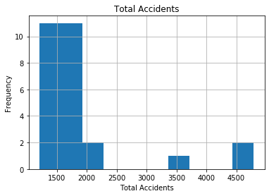
Total Accidents Histogram
Outliers: No outliers

Slide 8
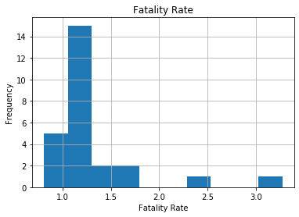
Fatality Rate Histogram
Outliers: No outliers

Slide 9
Mean, Mode, Spread of Variables
ActvTtl
Mean = 203154.73
Mode = N/A
Spread = 1,039,115,088.44
FltHrsTtl
Mean = 26470.46
Mode = N/A
Spread = 15,620,603.60
AccTtl
Mean = 1926.88
Mode = N/A
Spread = 876,368.49
FatalTtl
Mean = 613.62
Mode = N/A
Spread = 51330.01
FatalRT
Mean = 1.30
Mode = N/A
Spread = .2622

Slide 10
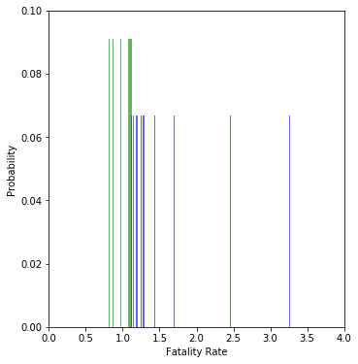
PMF – Total Fatality Rate 1960-2005 Vs. 2006-2017
1960-2005
2006-2017

Slide 11
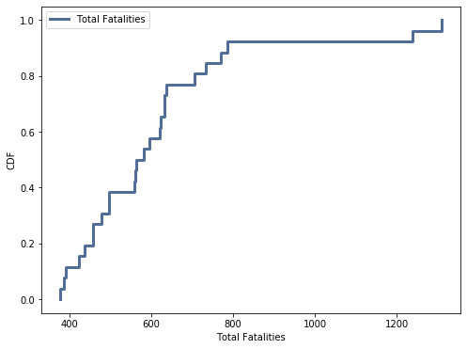
CDF – Total Fatalities

Slide 12
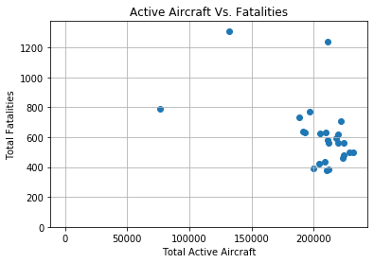
Scatter Plot – Active Aircraft vs Fatalities

Slide 13
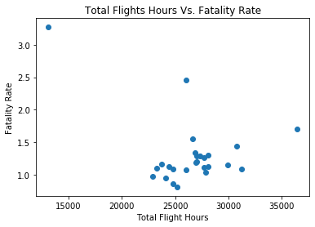
Scatter Plot – Total Flight Hours vs. Fatality Rate

Slide 14
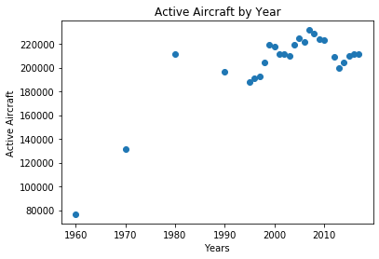
Scatter Plot - Active Aircraft by Year

Slide 15
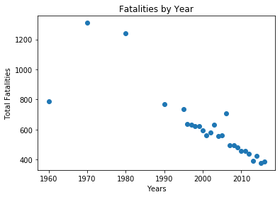
Scatter Plot – Fatalities By Year

